Slide 1



A Survey on Fault Injection Techniques
Nafisa Anjum Graduate Research Assistant Louisiana State University

Slide 2
Introduction
Fault injection provides a method of assessing the dependability of a system under test. It involves inserting faults into a system and monitoring the system to determine its behavior in response to a fault.
Factors to dependability:
Fault is a physical defect, imperfection, or flaw that occurs within some hardware or software component.
Error is a deviation from accuracy or correctness and is the manifestation of a fault.
Failure is the non-performance of some action that is due or expected.
In terms of cost and time, it becomes therefore crucial to perform a thorough analysis of the failure modes of the circuit if possible early in the design process and at least before any manufacturing.

Slide 3
Types of fault
Fault is categorized into 2 types:
a. Hardware
b. Software
Hardware Faults:
Hardware/Physical Fault that arise during system operation are best classified by their duration: Permanent, transient, or intermittent.
Permanent faults: Caused by irreversible component damage, such as a semiconductor junction that has shorted out because of thermal aging, improper manufacture, or misuse. Recovery can only be accomplished by replacing or repairing the damaged component or subsystem.
Transient faults: Triggered by environmental conditions such as power-line fluctuation, electromagnetic interference, or radiation. Rarely do lasting damage but harder to detect.
Intermittent faults: Caused by unstable hardware or varying hardware states. They can be repaired by replacement or redesign.

Slide 4
Types of fault
Software Faults:
Software faults are always the consequence of incorrect design, at specification or at coding time. During the process of software development, faults can be created in every step: Requirement definition, requirement specifications, design, implementation, testing, and deployment. And these faults can be cataloged to:
Function faults: Incorrect or missing implementation that requires a design change to be corrected.
Algorithm faults: Incorrect or missing implementation that can be fixed without the need of design change.
Timing/serialization faults: Missing or incorrect serialization of shared resources.
Checking fault: Missing or incorrect validation of data, or incorrect loop, or incorrect conditional
statement.
Assignment fault: Values assigned incorrectly or not assigned.

Slide 5
Why fault injection?
Fault injection tries to determine whether the response of the system matches with its specifications, in presence of a defined range of faults.
Fault injection techniques provide a way for fault removal
An understanding of the effects of real faults and thus of the related behavior of the target system in terms of functionality and performance.
Identifying weak links in the design: For example parts of the system within which a single fault could lead to severe consequences.
Exploring the effects of different workloads (different input profiles and environments) on the effectiveness of fault tolerant mechanisms.
Estimating the failure coverage and latency (lag/delay) of fault tolerant mechanisms.

Slide 6
Fault injection techniques
In this paper, we will study 4 fault injection techniques:
Hardware-based fault injection
Software-based fault injection
Simulation-based fault injection
Emulation-based fault injection

Slide 7
Hardware based fault injection
Hardware-based fault injection involves augmenting the system under analysis with specially designed test hardware to allow for the injection of faults into the system and examine the effects.
Benefits:
· Can access locations that is hard to be accessed by other means.
· High time-resolution for hardware triggering and monitoring.
· Well suited for the low-level fault models.
· Not intrusive.
· Experiments are fast.
· No model development or validation required.
· Able to model permanent faults at the pin level.

Slide 8
Hardware based fault injection
Drawbacks:
· Can introduce high risk of damage for the injected system.
· High level of device integration, multiple-chip hybrid circuit, and dense packaging technologies limit accessibility to injection.
· Low portability and observation ability.
· Limited set of injection points and limited set of injectable faults.
· Requires special-purpose hardware in order to perform the fault injection experiments.
Tools: RIFLE, FOCUS, MESSALINE, FIST (Fault Injection System for Study of Transient Fault Effect), MARS (Maintainable Real-time System)

Slide 9
Software based fault injection
Software fault injections are more oriented towards implementation details, and can address program state as well as communication and interactions. Faults are mis-timings, missing messages, replays, corrupted memory or registers, faulty disk reads, and almost any other state the hardware provides access to.
Benefits:
· Can be targeted to applications and operating systems.
· Experiments can be run in near real-time.
· Does not require any special-purpose hardware; low complexity, low development and low implementation cost.
· No model development or validation required.
· Can be expanded for new classes of faults.

Slide 10
Software based fault injection
Drawbacks:
· Limited set of injection instants.
· It cannot inject faults into locations that are inaccessible to software.
· Does require a modification of the source code to support the fault injection.
· Limited observability and controllability.
· Very difficult to model permanent faults.
Tools: FERRARI (Fault and Error Automatic Real-Time Injection), FTAPE (Fault Tolerance and Performance Evaluator), FIAT (Fault Injection-based Automated Testing), XCEPTION, DOCTOR and so on.

Slide 11
Simulation based fault injection
Simulation-based fault injection involves the construction of a simulation model of the system under analysis, including a detailed simulation model of the processor in use. The simulation models are developed using a hardware description language such as VHDL. Faults are injected into VHDL models of the design and excited by a set of input patterns.
Benefits:
· Can support all system abstraction levels.
· Not intrusive.
· Full control of both fault models and injection mechanisms.
· Low cost computer automation; does not require any special-purpose hardware.
· Maximum amount of observability and controllability.
· Allows performing reliability assessment at different stages in the design process.
· Able to model both transient and permanent faults.

Slide 12
Simulation based fault injection
Drawbacks:
· Large development efforts.
· Time consuming (experiment length).
· Model is not readily available.
· Accuracy of the results depends on the goodness of the model used.
· No real time faults injection possible in a prototype.
· Model may not include any of the design faults that may be present in the real hardware.
Tools: VERIFY (VHDL-based Evaluation of Reliability by Injection Faults Efficiently), MEFISTO-C, HEARTLESS, FTI (Fault Tolerance Injection)

Slide 13
Emulation based fault injection
For emulation, the circuit to analyze is implemented onto the FPGA using a classical synthesis, placement and routing design flow starting from the high-level circuit description. The development board is connected to a host computer, used to define the fault injection campaign, control the injection experiments and display the results.
Benefits:
· Injection time is more quick compared with simulation based techniques.
· The experimentation time can be reduced by implementing partially or totally the input pattern generation in the FPGA. These patterns are already
known when the circuit to analyze is synthesized.

Slide 14
Emulation based fault injection
Drawbacks:
· The initial VHDL description must be synthesizable and optimized to avoid requiring a too large and costly emulator and to reduce the total running time during the injection campaign.
· The cost of a general hardware emulation system and/or the implementation complexity of a dedicated FPGA based emulation
board.
· The emulation is only used to analyze the functional consequences of a fault.
· When using a FPGA-based development board, the main limitation becomes the number of I/Os of the programmable hardware. Necessity of high speed communication link between the host computer and the emulation board.

Slide 15
Conclusion
Fault injection is an important technique for the evaluation of design metrics such as reliability, safety and fault coverage.
Most recent research in this area is converging towards hybrid fault injection combining the benefits of both hardware and software fault injection techniques, while avoiding most of their disadvantages. This is becoming feasible due to the latest advancements in the FPGA technology.
The hybrid approach combines the versatility of software fault injection and the accuracy of hardware monitoring. given the significant gain in controllability and observation with a simulation-based approach, it might be useful to combine a simulation-based approach with one of the others in order to more fully exercise the system under analysis using tools like LIVE, SWIFI.

Slide 16
A survey on fault injection methods of digital integrated circuits
Nafisa Anjum Graduate Research Assistant Louisiana State University

Slide 17
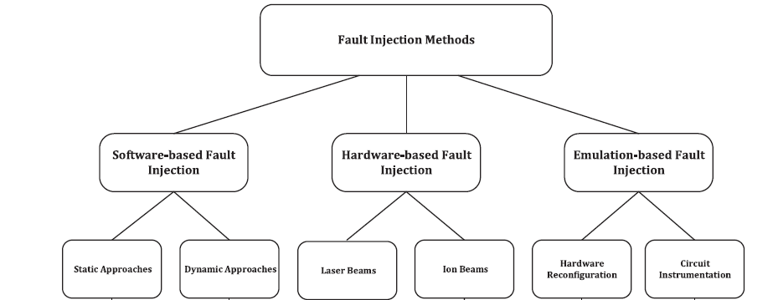
Introduction
This paper studies hardware, software and emulation based fault injection techniques in detail.
Fig.1 : Types of fault category

Slide 18
Triple Masking Effects
When a particle strikes a chip surface, Single Event Transient (SET) pulse is generated. SET may be propagated through the logic gate until it reaches to one of the latching components of the circuit and be stored in it.
There are some barriers through the path from the fault location to the latching components of the circuit that may prevent the fault to become an error. These factors are known as triple masking effects which includes electrical, timing, and logical masking effect.
Due to these effects, SET gets dissolved but if it is not dissolved, it will be stored as a Single Event Upset (SEU) or soft error in the circuit.
One of the most important parameters in evaluating the reliability of the circuit is the Soft Error Rate (SER).

Slide 19
Software based fault injection
Dynamic approaches:
In dynamic approaches, first one (or more than one) faults is inserted into the circuit and then, the circuit is simulated with different input vectors to compute the number of faults that are latched and converted to the error.
In Ref. [1], the proposed fault injection method uses two type of element pre-characterizations called logical pre-characterization and flip-flop pre-characterization.
Another framework based on pre-characterization approach called “SEAT-LA” is presented in Ref. [2]. SEAT-LA supports the designs which are based on cell libraries. These libraries are characterized based on the soft error rate.
An approach presented in Ref. [3] aims to avoid the unnecessary details of injected faults to achieve a better speed-up during the simulation process. For this purpose, the authors categorize the faults sets into three subsets and for each subset, they choose the fastest abstraction level to inject faults (i.e. transfer level, instruction-set level, and host-compiled level).

Slide 20
Software based fault injection
Static approaches:
In static approaches that are also considered as the approximate approaches, two group of symbolic and analytical methods are used. In the symbolic approaches, specific data structures such as matrices or graphs are used to keep the information about the triple masking effects. The analytical approaches take advantages of the mathematical formulations such as Boolean satisfaction or probability rules to evaluate the impacts of triple masking effects.
In Ref. [4], an approach is presented in which the circuit under study and the transient pulses are both defined as a matrix. Then, the effect of the transient pulse on the circuit is investigated using some presented operators on these matrices.

Slide 21
Software based fault injection
In Ref. [5], an approach is presented to analyze the susceptibility of a combinational circuit to soft errors based on the (Binary Decision Diagram) BDD and the circuit partitioning.
To compute all three masking factors uniformly and consider the effects of the re-convergent paths in the fault injection process and the SER estimation, an approach is presented in Ref. [6] that uses the BDD and the Algebra Decision Diagram (ADD) simultaneously.
The presented approach in Ref. [7] tries to make a tradeoff between the accuracy of the estimation and the amount of information needed for SER estimation.

Slide 22
Hardware based fault injection
Physical fault injection is performed either by contact-based approaches in which the external interface of the integrated circuit is perturbed (i.e. pin-level active probes and socket insertion), or without contact approaches in which some parts of the design are bombarded with the external energy resources (i.e. beams of laser, heavy ions, protons, and neutrons) to simulate the real faulty environment for the digital components.
Example of a pin-level fault injection is introduced in Ref. [8]. The architecture of this tool contains a trace memory collecting the data on the processor bus after injecting the faults to the target processor using the insertion technique.
Another contact-based fault injection tool [9] uses both active probes and socket insertion to inject faults to the target circuit. In this approach, multiple faults can be injected to the circuit as well as the single ones and many fault models are supported.

Slide 23
Hardware based fault injection
A physical fault injection framework is presented in Ref. [10] that uses the proton beams radiation with the intensity between 6 MeV and 37 MeV.
In Ref. [11], a novel laser fault injection approach is presented that attacks thorough the sides of the IC in order to come over the problems with laser fault injection of newer packaging technologies.
Furthermore, in Ref. [12], some control structures are designed to move the beam radiation device in order to inject faults into the different parts of the circuit.

Slide 24
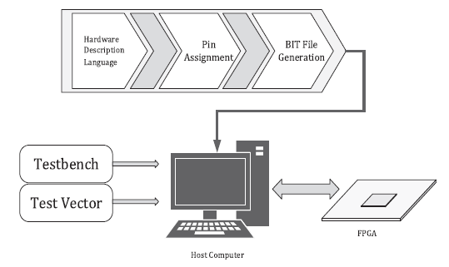
Emulation based fault injection
Fault emulation techniques try to benefit from the speed of the hardware-based approaches and the accuracy of the software-based approaches.
Emulation-based fault injection approaches using hardware reconfiguration:
Fig.2 : Emulation injection approach using FPGA

Slide 25
Emulation based fault injection
The connection framework between the host computer and the FPGA plays the most important role in the fault emulation speed and it is always known as the bottleneck of these approaches.
In Ref. [13], designers tried to minimize the connections between the host computer and the FPGA.
in Ref. [14], an approach is for injecting the SEU into the memory units of the circuit using the Altera FPGA. Since this approach applies the commercial tools for different steps of fault injection process, it makes this approach to be very flexible.
In Ref. [15], the circuit is separated into two parts including the combinational and the sequential logic. Then, after injecting a SET or Multiple Event Transients (MET) in the combinational part of the circuit, the propagation effects are tracked using software simulations until reaching to the latching components of the circuit.

Slide 26
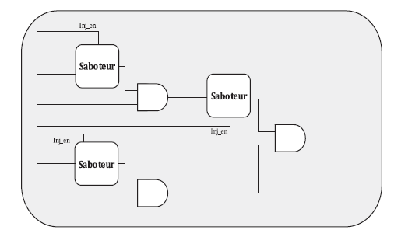
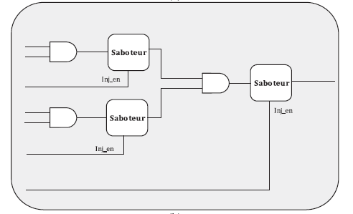
Emulation based fault injection
Emulation-based fault injection approaches based on instrumenting the circuit:
In this approach, an extra part usually called “saboteur” is added to the circuit for each fault location which is responsible for changing the value of the specific signal regarding to the fault model chosen by the designer.
Fig.3 : Emulation injection approach using saboteur I/O parts

Slide 27
Emulation based fault injection
The approach in Ref [16] is based on sampling the amount of the voltage passing through the gates such that changing the voltage level from high to low and low to high is sampled and stored on the FPGA.
An approach presented in Ref. [17] tries to reduce the area overheads in instrumented-based fault emulation approaches by performing a probability-aware fault injection.
Another approach trying to enhance the area overhead is presented in Ref. [18], which aims for SEU modelling by changing the default Xilinx libraries that is capable of performing the fault emulation for the large-scale circuits.

Slide 28
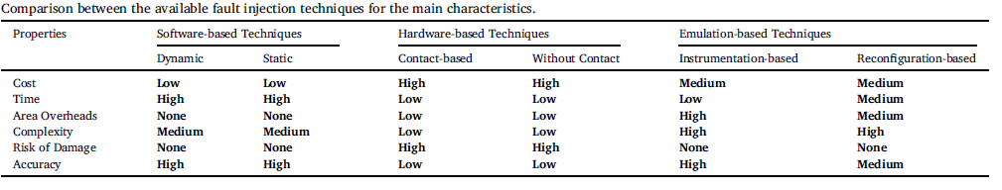
Comparison between fault injection techniques
Table.1: Comparison between the available fault injection techniques for the main characteristics.

Slide 29
Conclusion
High computational overhead in software-based approaches and unaffordable equipment costs in hardware-based approaches makes the motivation of using the emulation-based approaches for performing the fault injection process in digital circuits.
However, choosing a fault injection technique depends on many factors such as budget, time and complexity.

Slide 30
References
R. Ramanarayanan, V.S. Degalahal, R. Krishnan, K. Jungsub, V. Narayanan, Y. Xie, M.J. Irwin, K. Unlu, Modeling soft errors at the device and logic levels for combinational circuits, IEEE Trans. Dependable Secure Comput. 6 (3) (2009) 3007–3017.
R. Rajaraman, J.S. Kim, V. Narayanan, Y. Xie, M.J. Irwin, SEAT-LA: a soft error analysis tool for combinational logic, in: Proceedings of the International Conference on VLSI Design, 2006, pp. 159–165.
R. Petra, U. Maier, D. Sharif, Mueller-Gritschneder, U. Schlichtmann, Efficient fault injection for embedded systems: as fast as possible but as accurate as necessary, in: Proc. IEEE 24th International Symposium on On-Line Testing and Robust System Design, 2018, pp. 119–122.
L. Entrena, M. Valderas, R. Cardenal, A. Lindoso, M.P. Garcia, C. Lopez-Ongil, Soft error sensitivity evaluation of microprocessors by multilevel emulation-based fault injection, IEEE Trans. Comput. 61 (3) (2012) 313–322.
B. Zhang, M. Orshansky, Symbolic simulation of the propagationand filtering oftransient faulty pulses, in: Proceedings of the Workshop on Silicon Errors in Logic:System Effects, 2005, pp. 458–469.
N. Miskov-Zivanov, D. Marculescu, Modeling and optimization for soft-error reliability of sequential circuits, IEEE Trans. Comput. Aided Des. Integr CircuitsSyst. 27 (No. 5) (2008) 803–816N.
Kehl, W. Rosenstiel, An efficient SER estimation method for combinational circuits, IEEE Trans. Reliab. 60 (4) (2011) 742–747.
H.S. Madeira, M. Rela, F. Moreira, J.G. Silva, RIFLE: a general purpose pin-level fault injector, in: K. Echtle, D. Hammer, D. Powell (Eds.), Proc. 1st European Dependable Computing Conference (EDCC ’94), Springer-Verlag, 1994, pp. 197–216.
J. Arlat, M. Aguera, L. Amat, Y. Crouzet, E. Martins, D. Powell, J.-C. Fabre, J.- C. Laprie, Fault injection for dependability validation: a methodology and some applications, IEEE Trans. Softw. Eng. 16 (2) (Feb. 1990) 166–182.

Slide 31
References
J. Rodriguez, A. Baldomero, V. Montilla, J. Mujal, LLFI: lateral laser fault injectionattack”, in: Proc. Workshop on Fault Diagnosis and Tolerance in Cryptography (FDTC), 2019, pp. 41–47.
R. Nyberg, J. Heyszl, D. Heinz, G. Sigl, Enhancing fault emulation of transient faults by separating combinational and sequential fault propagation, in: ACM Great LakesSymposium on VLSI, 2016, pp. 209–214.
J.M. Mogollon, H. Guzman-Miranda, J. Napoles, J. Barrientos, M.A. Aguirre FTUNSHADES2: a novel platform for early evaluation of robustness against SEE, in Proc. 2011 12th Eur. Conf. On Radiat. Its Effects Compon. Syst., 2012.
M. Ebrahimi, A. Mohammadi, A. Ejlali, S.G. Miremadi, A fast, flexible, and easy-todevelop FPGA-based fault injection technique, Microelectron. Reliab. 54 (5) (2014 1000–1008.
L. Entrena, M.G. Valderas, R.F. Cardenal, M.P. Garcia, C.L. Ongil, SET emulation considering electrical masking effects, IEEE Trans. Nucl. Sci. 56 (2009) 2021–2025.
F.B. Armelin, L. Navinery, R. d'Amore, Probability aware fault-injection approach for SER estimation, in: IEEE 19th Latin-American Test Symposium (LATS), 2018.
W. Mansour, R. Velazco, An automated SEU fault-injection method and tool for HDL-based designs, IEEE Trans. Nucl. Sci. 60 (4) (2013) 2728–2733.
L. Entrena, M. Valderas, R. Cardenal, A. Lindoso, M.P. Garcia, C. Lopez-Ongil, Soft error sensitivity evaluation of microprocessors by multilevel emulation-based fault injection, IEEE Trans. Comput. 61 (3) (2012) 313–322.
B. Zhang, M. Orshansky, Symbolic simulation of the propagationand filtering oftransient faulty pulses, in: Proceedings of the Workshop on Silicon Errors in Logic:System Effects, 2005, pp. 458–469.

Slide 32
Thank you!

Slide 33

ReChip
No other tech node combined like that in ECO-Chip
The ACT carbon footprint model is designed to quantify the emissions of running a software application on given hardware substrate. The overall emissions, CF, are the combination of the operational (OPCF) and embodied (ECF) emissions. The embodied emissions are discounted based on the application run-time, T, and the overall lifetime of the system, LT.
T= application runtime
LT = hardware lifetime
ECF = embodied carbon footprint
OCF= operational carbon footprint
The embodied carbon emissions are amortized over the system's lifetime, meaning that reusing hardware over multiple applications reduces the per-use footprint.

Slide 34
ReChip
Metric | Formula | Use Case
Carbon-Delay Product (CDP) | CDP=ECF×D | Balances embodied carbon and performance (e.g., data center hardware)
Carbon-Energy Product (CEP) | CEP=ECF×E | Balances embodied carbon and energy efficiency (e.g., mobile devices)
Carbon²-Energy Product (C²EP) | (C^2)EP=EC(F^2)×E | Prioritizes reducing embodied carbon over energy (e.g., high-footprint devices)
Carbon-Energy² Product (CE²P) | C(E^2)P=ECF×(E^2) | Prioritizes operational efficiency over embodied carbon (e.g., energy-intensive systems)

Slide 35
ReChip
Where:
ECF = Embodied Carbon Footprint (kg CO₂) from manufacturing.
E = Total operational energy consumption (Joules).
D= Execution delay (seconds).
**delay (D) represents the execution time required for a hardware system to complete a specific workload
Where it is infeasible to quantify the lifetime carbon footprint of a hardware platform early in the design cycle, these metrics can aid designers to incorporate sustainability into hardware design space exploration. Might help to integrate and explain with metrics for higher carbon estimations.
To gain intuition they start with two frequently used metrics by computer architects to design hardware systems: energy delay product (EDP) and energy-delay-area (EDAP) product [1].
ACT uses processor, storage, packaging for emb carbon.

Slide 36
ReChip
To modify GreenFPGA for an eFPGA+ASIC SoC, account the interactions between the reconfigurable FPGA and fixed-function ASIC. eFPGA, being embedded, might have a smaller footprint than a standalone FPGA. One modification could be to separate the carbon footprint calculations for both components, extending the model to address their integration.
Integrating eFPGA into an ASIC design could increase the design complexity, leading to a higher design carbon footprint (CFP). If the eFPGA is embedded within the same die as the ASIC, the manufacturing footprint may also change.

Slide 37
ReChip
To make changes,
For design CFP, combine ASIC and eFPGA design, plus integration efforts.
For embodied CFP, calculate ASIC and eFPGA separately and apply scaling factors for packaging.
For operational CFP, include the additional development overhead for reconfigurable eFPGA in the SoC.
If the eFPGA is reprogrammable, the model should account for its reuse across multiple applications, distributing its embodied CFP over several lifetimes, while the ASIC part incurs a one-time cost.
include an input parameter to specify the eFPGA-to-ASIC fraction and compute CFP accordingly.
For the eFPGA, I need to adjust the FPGA CFP model (Equation (2)) to consider its reduced reconfigurability overhead and smaller area compared to a standalone FPGA.
the embodied and deployment CFP models (Equations (3) and (7)) to compute individual contributions for each component, adding an integration overhead term to account for the combined effects.
Could use ACT eqn for total CFP

Slide 38
ReChip
The steps could be:
Decompose the SoC into ASIC and eFPGA.
Apply the existing models to each separately for embodied and operational CFP.
Include an integration overhead term for design, manufacturing, and packaging costs.
Adjust for the reconfigurability benefits and costs of the eFPGA.

Slide 39
ReChip
Since the eFPGA is reconfigurable and its embodied carbon is incurred just once (like FPGA), the modifications could include:
Adding a hybrid mode with a parameter, "frac", to represent the fraction of ASIC and eFPGA or the ratio.
Combining the embodied carbon of both blocks and adding an integration overhead (C_int) to account for extra costs from combining the two.
To calculate the embodied carbon for ReChip: C_emb, ReChip = C_emb,ASIC + C_emb,eFPGA + C_int.
Separate Deployment CFP: For the ASIC block, compute the deployment carbon based on its fixed usage. For the eFPGA block, model deployment carbon in a way that amortizes its embodied cost over multiple reconfigurations (i.e., multiple applications).????
New User Inputs and Parameters:
The fraction (or area/power ratio) of the ASIC versus eFPGA in the ReChip.
Integration overhead factors.
Distinct design, manufacturing, and EOL parameters for both blocks.
Reconfiguration frequency for the eFPGA to properly amortize its embodied cost.

Slide 40
References
Sheng Li, Jung Ho Ahn, Richard D Strong, Jay B Brockman, Dean M Tullsen, and Norman P Jouppi. 2009. McPAT: An integrated power, area, and timing modeling framework for multicore and manycore architectures. In Proceedings of the 42nd Annual IEEE/ACM International Symposium on Microarchitecture. 469–480.

